Slide 1
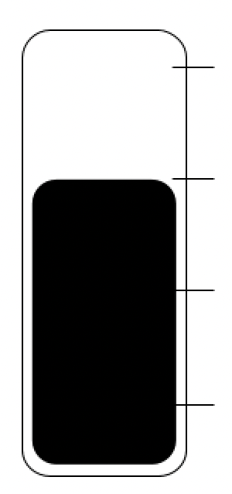
0% Success
Do you want to invest in this project?

Slide 2
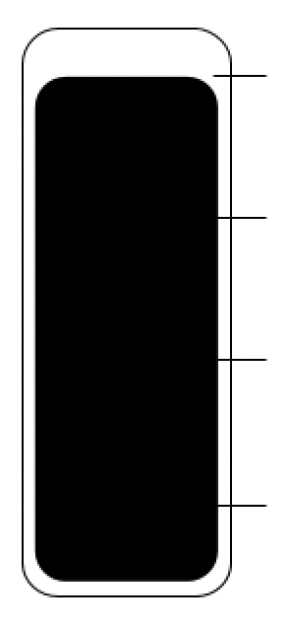
0% Success
Do you want to invest in this project?

